Slide 1
Error Detection
and
Correction

Slide 2

Note
Data can be corrupted
during transmission.
Some applications require that
errors be detected and corrected.

Slide 3
10-1 INTRODUCTION
Let us first discuss some issues related, directly or indirectly, to error detection and correction.

Slide 4
Note
In a single-bit error, only 1 bit in the data unit has changed.

Slide 5

Figure 10.1 Single-bit error

Slide 6
Note
A burst error means that 2 or more bits in the data unit have changed.

Slide 7

Figure 10.2 Burst error of length 8

Slide 8
Note
To detect or correct errors, we need to send extra (redundant) bits with data.

Slide 9
Redundancy
To be able to detect or correct errors, we need to send some extra bits with our data.
These redundant bits are added by the sender and removed by the receiver.
10.<number>

Slide 10
Note
To detect or correct errors, we need to send extra (redundant) bits with data.
10.<number>

Slide 11
Detection Versus Correction
In error detection, we are looking only to see if any error has occurred.
The answer is a simple yes or no.
  Not even interested in the number of errors
  A single-bit error is the same for us as a burst error
10.<number>

Slide 12
Detection Versus Correction
In error correction, we need to know the exact number of bits that are corrupted and more importantly, their location in the message.
The number of the errors and the size of the message are important factors
10.<number>

Slide 13

Figure 10.3 The structure of encoder and decoder

Slide 14

Figure 10.4 XORing of two single bits or two words

Slide 15
10-2 BLOCK CODING
In block coding, we divide our message into blocks, each of k bits, called datawords. We add r redundant bits to each block to make the length n = k + r. The resulting n-bit blocks are called codewords.

Slide 16

Figure Process of error detection in block coding

Slide 17
Example 10.2
Let us assume that k = 2 and n = 3. Table 10.1 shows the list of datawords and codewords. Later, we will see how to derive a codeword from a dataword.
Assume the sender encodes the dataword 01 as 011 and
sends it to the receiver. Consider the following cases:
1. The receiver receives 011. It is a valid codeword. The
receiver extracts the dataword 01 from it.

Slide 18
Example 10.2 (continued)
2. The codeword is corrupted during transmission, and
111 is received. This is not a valid codeword and is
discarded.
3. The codeword is corrupted during transmission, and
000 is received. This is a valid codeword. The receiver
incorrectly extracts the dataword 00. Two corrupted
bits have made the error undetectable.

Slide 19

Table 10.1 A code for error detection (Example 10.2)

Slide 20
Note
An error-detecting code can detect
only the types of errors for which it is designed; other types of errors may remain undetected.

Slide 21

Figure 10.7 Structure of encoder and decoder in error correction

Slide 22
10-3 LINEAR BLOCK CODES
Almost all block codes used today belong to a subset called linear block codes. A linear block code is a code in which the exclusive OR (addition modulo-2) of two valid codewords creates another valid codeword.

Slide 23

Table 10.3 Simple parity-check code C(5, 4)

Slide 24
Example 10.12
Let us look at some transmission scenarios. Assume the sender sends the dataword 1011. The codeword created from this dataword is 10111, which is sent to the receiver. We examine five cases:
1. No error occurs; the received codeword is 10111. The
syndrome is 0. The dataword 1011 is created.
2. One single-bit error changes a₁ . The received
codeword is 10011. The syndrome is 1. No dataword
is created.
3. One single-bit error changes r₀ . The received codeword
is 10110. The syndrome is 1. No dataword is created.

Slide 25
Example 10.12 (continued)
4. An error changes r₀ and a second error changes a₃ .
The received codeword is 00110. The syndrome is 0.
The dataword 0011 is created at the receiver. Note that
here the dataword is wrongly created due to the
syndrome value.
5. Three bits—a₃, a₂, and a₁—are changed by errors.
The received codeword is 01011. The syndrome is 1.
The dataword is not created. This shows that the simple
parity check, guaranteed to detect one single error, can
also find any odd number of errors.

Slide 26

Figure 10.10 Encoder and decoder for simple parity-check code

Slide 27
Note
A simple parity-check code can detect an odd number of errors.

Slide 28

Figure 10.11 Two-dimensional parity-check code

Slide 29

Figure 10.11 Two-dimensional parity-check code

Slide 30

Figure 10.11 Two-dimensional parity-check code

Slide 31
10-4 CYCLIC CODES
Cyclic codes are special linear block codes with one extra property. In a cyclic code, if a codeword is cyclically shifted (rotated), the result is another codeword.

Slide 32

Figure 10.14 CRC encoder and decoder

Slide 33

Figure 10.15 Division in CRC encoder

Slide 34

Figure 10.21 A polynomial to represent a binary word

Slide 35
Note
The divisor in a cyclic code is normally called the generator polynomial
or simply the generator.

Slide 36

Table 10.7 Standard polynomials

Slide 37
Hamming Distance
Central concepts in coding for error control.
The Hamming distance between two words (of the same size) is the number of differences between the corresponding bits.
We show the Hamming distance between two words x and y as d(x, y)
The Hamming distance can easily be found if we apply the XOR operation on the two words and count the number of 1s in the result.
Note that the Hamming distance is a value greater than zero.
10.<number>

Slide 38
Find the Hamming Distance
Q1. 000,011
Q2. 10101,11110
10.<number>

Slide 39
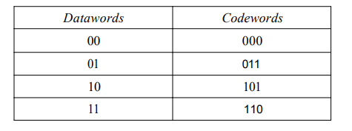
Minimum Hamming Distance
The minimum Hamming distance is the smallest Hamming distance between all possible pairs.
The d_{min} in this case is 2.
10.<number>

Slide 40
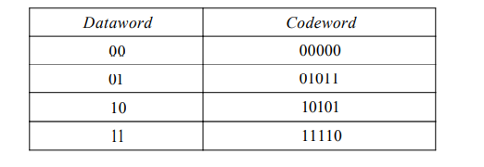
Find the minimum hamming distance given in Table 2
10.<number>

Slide 41
Three parameters of Coding Scheme
Any Coding scheme needs to have atleast three parameters.
The codeword size n,
The dataword size k, and the minimum Hamming distance d_{min}.
10.<number>

Slide 42
Relationship between Hamming Distance and Error
When a codeword is corrupted during transmission, the Hamming distance between the sent and received codewords is the number of bits affected by the error.
The Hamming distance between the received codeword and the sent codeword is the number of bits that are corrupted during transmission.
10.<number>

Slide 43
Relationship between Hamming Distance and Error
If the codeword 00000 is sent and 01101 is received, 3 bits are in error, and the Hamming distance between the two is d(00000, 01101) =3.
10.<number>

Slide 44
Minimum Distance for Error Detection
To find the minimum Hamming distance in a code if we want to be able to detect up to s errors.
If s errors occur during transmission, the Hamming distance between the sent codeword and the received codeword is s.
To detect up to s errors, the minimum distance between the valid codes must be s + 1; so that the received codeword does not match a valid codeword.
10.<number>

Slide 45
Minimum Distance for Error Detection
If the minimum distance between all valid codewords is s + 1, the received codeword cannot be erroneously mistaken for another codeword.
To guarantee the detection of up to s errors in all cases, the minimum Hamming Distance in a block code must be dmin = s+1
10.<number>

Slide 46
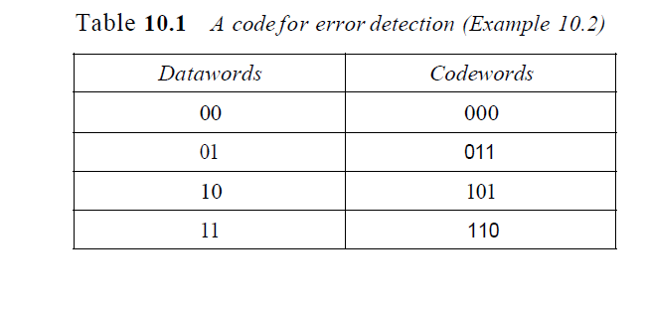
Example
10.<number>

Slide 47
Example
The minimum Hamming distance for our first code scheme (Table 10.1) is 2.
This code guarantees detection of only a single error.
For example, if the third codeword (l01) is sent and one error occurs, the received codeword does not match any valid codeword.
If two errors occur, however, the received codeword may match a valid codeword and the errors are not detected
10.<number>

